Slide 1
Auto Test System Introduction

Slide 2
Scope
To shorten test cycle time and quickly get data log.

Slide 3
Need to know before auto test
Only new file creation can trigger tool. Re-transfer file will not trigger.

Slide 4
Mechanism
As Is
To Be
Test Plan
Test Program
Data log
Step1
Fuji provide test plan
Step2
Orange uses tool to generate test program
Step3
Orange sets test environment and run test program to get data log
Test Plan
Step1
Orange sets test environment
Step2
Fuji provide test plan
Test Program
Data log
Step3
Tool automatically generate test program and get data log

Slide 5
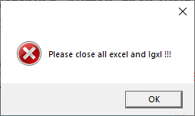
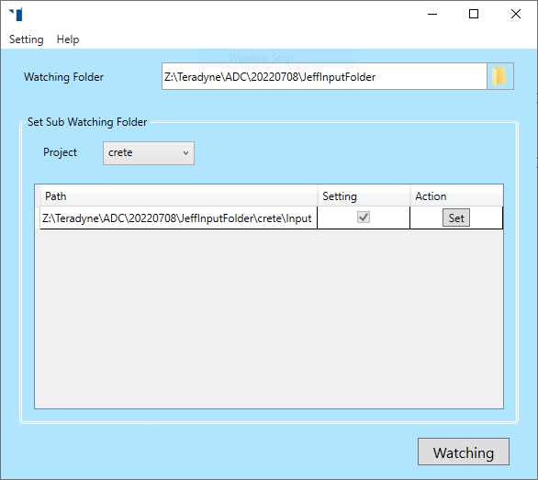
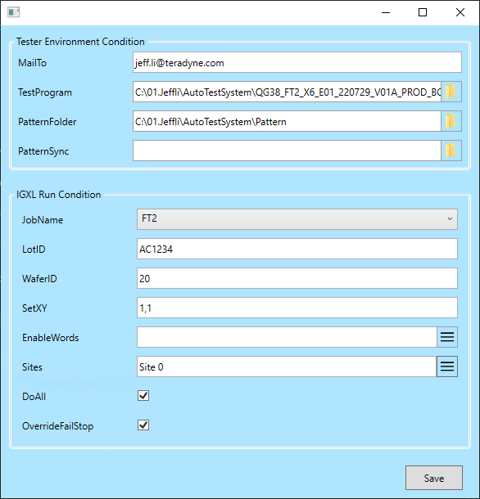
How to set Auto Test System
step1
Step1 : To close all excel and igxl application in the tester. If not, tool will show error message.
Step2 : To define watching folder, that can contains sub folder for different projects.
(Default folder : U:\TP-to-C651\PatternValidation\Input)
Step3 : To click “Set” button to open test environment window.
Step4 : To defining all input files, then click “Save” button to create Setting.ini. (One project can contain serval sub folders, but only the folder contains Setting.ini can trigger auto test)
Step5 : To click “Watching” button, then wait user deliver new input test. Auto test system will be a tray icon on the right side of the taskbar
test environment window
step2
step3
Can set for diff. test case.(ex. CP1/CP2)
step4
step5
tray icon

Slide 6
Format
Header
Use/Not Use
Not Use will be ignored.
Comment
Just record by user and Tool will do nothing.
Test instance name
To generate patset and instance name. If it is deplumation name, and tool will rename by
[Sheet]_[Row#]_Test instance name
AI type
Support for Data log/1D/2D
Data logging setting
512 FC
NA
DFC (-0.01,-0.02)

Slide 7
Format
Header
Timeset
It is name of timeset and should exist in timeset folder or test program.
Voltage Category
Syntax : [Dc_category] [Dc_selector]
Example : BinCut_X_X_X LV
Pattern#
Can be generic pattern or pattern name with date code
Example :
PP_OTC_C_IN01_BI_CXXX_BST_JTG_XXX_ALLFV_SI_SRVE_SMT
PP_OTC_C_IN01_BI_CXXX_BST_JTG_XXX_ALLFV_SI_SRVE_SMT_5_A0_1906290401
Pins or Variable
It can be power pin in pin map or variable in AC spec. Tool will base on Start/ Stop/Step to create Characterization condition.
Start/Stop/Step
Allow unit : V,mV,uV,Hz,KHz,Mhz
Example : 0.75mV

Slide 8
Format
Header
Order
Define sequence of X-axis and Y-axis for 2D shmoo, use comma as delimiter.
Example: VDD_ECPU,VDD_PCPU
Search
Define the name and arguments of search algorithm for shmoo, and use comma as delimiter.
Example: Jump 6;Linear
PS. The algorithm of 2D shmoo’ Y-axis can not be jump.
Temp. Condition
Ongoing

Slide 9
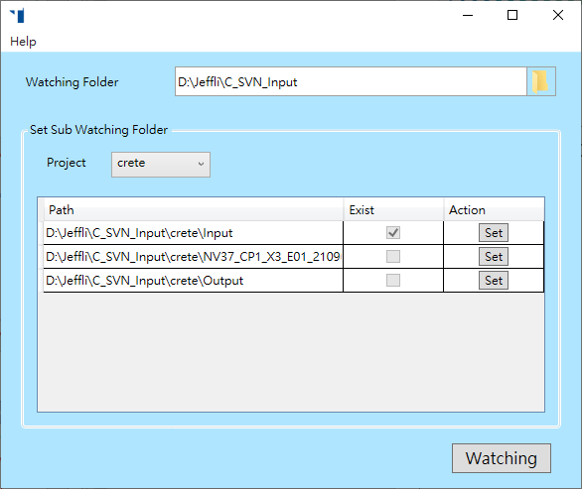
How to start/stop Auto Test System
Application Start
1) Click Watching Button and hide tool in taskbar.
Application Stop
1) Click tray icon in taskbar.
2) Click “X” to close the application.

Slide 10
Environment Setting
MailTo
Define mail list for result by “,”
TestProgram
Define original test program, and it be executed correctly.
PatternFolder
Default is [Path of TestProgram]\Pattern
Define Pattern/TimeSet/HardIP_AutoGen_Info_All.txt.
PatternSync
Define sync *.bat to catch the latest patterns from Fuji.

Slide 11
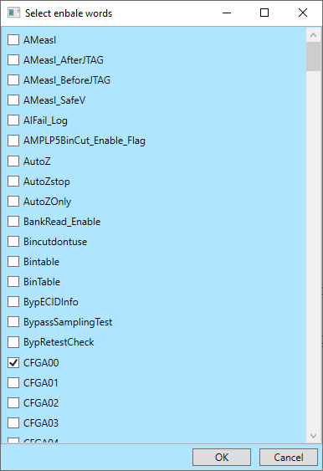
Environment Setting
JobName
Define job by user.
LodID
Define lot ID
WaferId
Define wafer ID
SetXY
Define start location of test.
EnableWords
User can define enable words in the flow.
Sites
User can define test site in test program.
DoAll/OverwriteFailStop
Turn on do all function for offline debug.
Select enable word from program

Slide 12
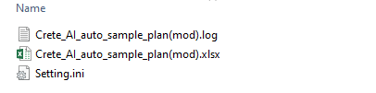
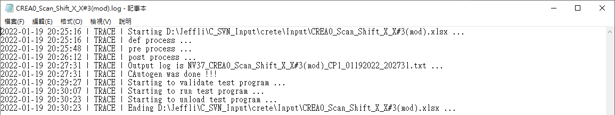
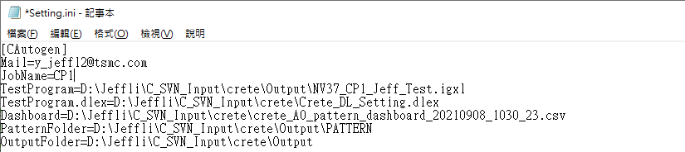
Watching Folder
C-Autogen test plan
Provided by user
Process log
Tool records history and errors when processing or program validation.
Setting.ini
Created by test environment window for test environment setting.

Slide 13
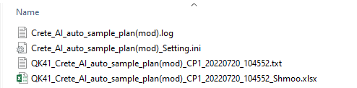
Output Folder
DataLog
The name is [origanl_test_plan_name]_[JobName]_[date_code].txt
Shmoo Report
The name is [origanl_test_plan_name]_[JobName]_[date_code]_Shmoo.xlsx
Process log
Setting.ini

Slide 14
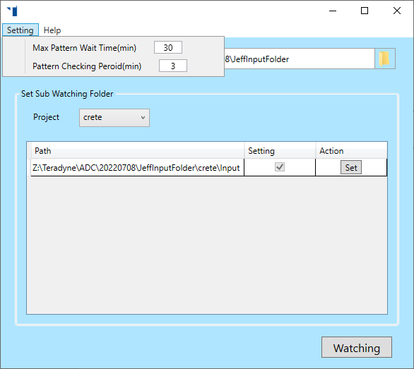
Pattern Sync Setting
Max Pattern Wait Time(min)
Default 30 mins
Pattern Checking Peroid(min)
Default 3 mins / one time

Slide 15
Environment check
Check if U:\TP-to-C651\PatternValidation\Input can be access
Check if U:\TP-to-C651\PatternValidation\Input\TesterStatus.xlsx can be access
Check to close all excel and Igxl before watching.

Slide 16
Input Check
Check if there setting.ini in input folder.
Check if pattern is existed in dashboard.
Check if pattern is existed in pattern folder.
Check if “pattern_dashboard” sheet is existed in test plan
Compare enable word in data log and user definition.
Add type of error for debug
Input,
Environment
Code

